Slide 1
Job Recommender System
Aakanchhya Sigdel
Sagar Bhandari
Subesh Bhandari
Tashi Lama
1

Slide 2
Introduction
Recommendation system
content-based methods
collaborative filtering
demographic filtering systems
hybrid approaches
Job recommendation
Job applicant subsystem
Job recruiter subsystem
2

Slide 3
Problem Definition
Job seekers and Job givers
Addressing their preferences on one another
Hard time searching for a company that values his/her skill sets
Surf through countless CVs of applicants
3

Slide 4
Objectives
Discussed in two categories:
Job Providers
Job Seekers
4

Slide 5
Research Methodology
Literature Review
Dynamic User Profile-Based Job Recommender System
Hybrid recommendation algorithm
According to the characteristics of user profiles
User profile classified into basic feature, extracted and behavior feature
Similarity calculated using updated basic features
Cold start problem
User-based collaborative filtering algorithm
5

Slide 6
Research Methodology
Applying Different Classification Techniques in Reciprocal Job Recommender System for Considering Job Candidate Preferences
CCRS (Classification – Candidate Reciprocal Recommendation System)
People-to-People recommendation
User profile, interaction and preference information
6

Slide 7
Research Methodology
Tree-based Contextual Learning for Online Job or Candidate Recommendation with Big Data Support in Professional Social Networks
Online mining and predicting system
User’s explicit information
Cold start problem
Context of new user’s information and implicit information of the previous users
Expandingly Tree-based and Dynamically Context-aware Online Learning algorithm (ETDC)
7

Slide 8
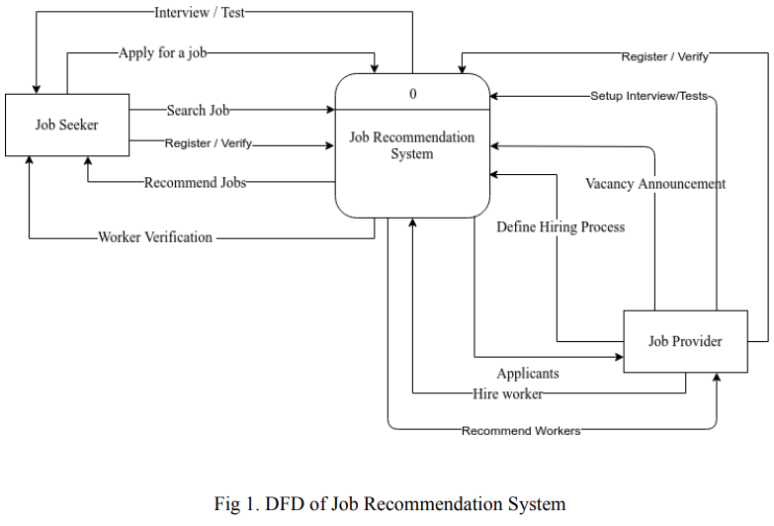
Research Methodology
Framework
8

Slide 9
Data Collection
Data Source : Kaggle.com
Scaled Down Version
Job Post
User History
User Profile
Training 70%
Testing 30%
9

Slide 10
Testing
Black Box Testing
Smoke Testing
Regression Testing
Stress Testing
System Testing
White Box Testing
Unit Testing
10

Slide 11
Expected Output
Recommend Suitable Jobs
Easy Hiring Process
User Friendly & Cross Platform
11

Slide 12
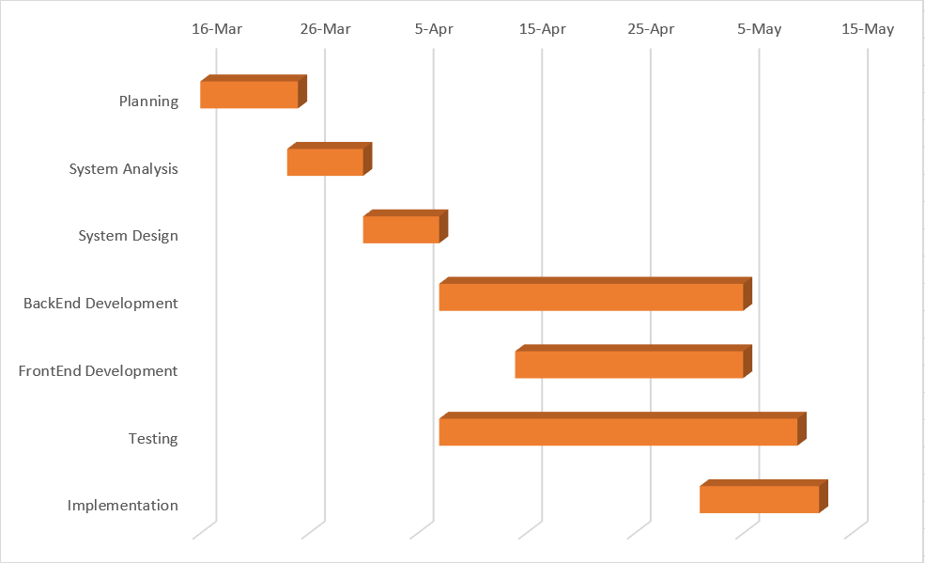
Gantt Chart
12

Slide 13
Conclusion
Job Recommendation system
Hybrid approach
Web based application
Platform for both job seekers and job recruiters
13

Slide 14
References
W. Hong, S. Zheng, H. Wang, Dynamic User Profile-Based Job Recommender System , (2013), pp. 1499-1503
M. Diaby and E. Viennet, Taxonomy-based Job Recommender Systems On Facebook and LinkedIn Profiles , (2014)
G. Ozcan and S.G. Oguducu , Applying Different Classification Techniques in Reciprocal Job Recommender System for Considering Job Candidate Preference , (2016), pp. 235-240
14

Slide 15
References
W. Shalaby, B. AlAila, M. Korayem, L. Pournajaf, K. AlJadda, S.Quinn, and W. Zadrozny, Help Me Find a Job: A Graph-based Approach for Job Recommendation at Scale , (2017)
B. Walek and P. Spackova, Content-based recommender system for online stores using expert system , (2018), pp. 164-165
15

Slide 16
References
W. Chen, Pan Zhou, S. Dong, S. Gong, M. Hu, K. Wang and D. Wu, Tree-based Contextual Learning for Online Job or Candidate Recommendation with Big Data Support in Professional Social Networks , vol. 4, (2016)
16

Slide 17
Thank you!
17

